Slide 1
Citizens Police Academy Alumni Association – CPAAA
North County 1st Precinct
Bi-Monthly – General Meeting
XX/XX/2022
Chapel Of The Cross Lutheran Church
Room # 9a – Lower Level
11645 Benham Road
St. Louis, MO 63138

Slide 2
Meeting Agenda
Call To Order
Prayer
Pledge of Allegiance
Roll Call Board Member
Office of the Quarter Presentation
North County Neighborhood Police Officers
Treasurer’s Report
Volunteer Pin Awards
CPAAA Membership Dues - $15.00 for 2022
CPAAA Merchandise 2022
Citizens Police Academy Class 2022
Volunteer Opportunities
CPAAA Open Position
CPAAA Facebook Private Group
CPAAA North County Website
Comments and/or Questions
Adjournment
Next Quarterly Meeting – 3/29/2022

Slide 3
Call To Order
President – Cindy Vogelsang

Slide 4
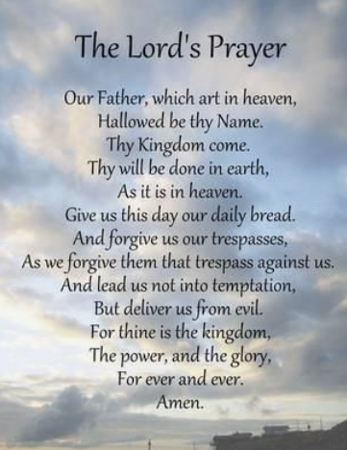
Prayer
President – Cindy Vogelsang

Slide 5
Pledge Of Allegiance
The Pledge of Allegiance to the Flag:
“I pledge allegiance to the Flag of the United States of America,
and to the Republic for which it stands, one Nation under God, indivisible, with liberty and justice for all.”

Slide 6
Roll Call - Board Members
Citizens Police Academy Alumni Association North County Chapter
Executive Board Members
President - Cindy Vogelsang - president@stlcocpaa.org - 314-680-1795
Vice President – Ron Malone- vice-president@stlcocpaaa.org – 314-210-0900
Treasurer – Barbara Lowes – treasury@stlcocpaaa.org
Secretary – Margarett Williams– secretary@stlcocpaaa.org
Board Members:
Geno Witherspoon, Sr. -
past-president@stlcocpaaa.org
Roland Martir -
mgmrpm@aol.com

Slide 7
Officer of the Quarter
The North County Neighborhood Police Officers (NPO Unit) has not nominated a
Officer of the Quarter
Officer Jason Kapayou

Slide 8
North County Neighborhood Police Officers:
Officer Jason Kapayou
Jkapayou@stlouiscountymo.gov
314-438-4622
Officer Wesley Bell
Nbell@stlouiscountymo.com
314-438-462

Slide 9
Treasurer’s Report - UPDATE
Treasurer - Barbara Lowes - treasury@stlcocpaaa.org

Slide 10
Volunteer Pin Awards
CPAAA Members:
Due to COVID-19 there were no Volunteer Pins Awarded for this Quarter
Thank you all for your time, commitment and dedication to the
CPAAA Organization.
President – Cindy Vogelsang
The Volunteer Pens are given to CPAAA Members that have participated
in 5 or more events.

Slide 11
CPAAA Membership Dues - $15.00 for 2022
Citizens Police Academy Alumni Association
North County Chapter
P.O. Box 2136
Florissant, MO 63032
CPAAA has established a CashApp Account for Community Donations -$CPAAANC
Please see the links below to get familiar with CashApp:
How to use CashApp
https://www.youtube.com/watch?v=PWpNhU-5Ck4
How to send money using CashApp
https://www.youtube.com/watch?v=PEAb2qg6agM
Please Contact President - Cindy Vogelsang
president@stlcocpaaa.org – 314-680-1795

Slide 12
CPAAA Merchandise 2022
Citizens Police Academy Alumni Association
North County Chapter
P.O. Box 2136
Florissant, MO 63032
CPAAA Gear For Sale
http://stlcocpaaa.org/cpaaagear.html
We would like to distribute CPAAA Merchandise ordered for 2021
Please Contact
Barb Lowes - treasury@stlcocpaaa.org
or
Geno Witherspoon - past-president@stlcocpaaa.org
314-304-7085
if you have any questions or concerns regarding the CPAAA Merchandise 2021.

Slide 13
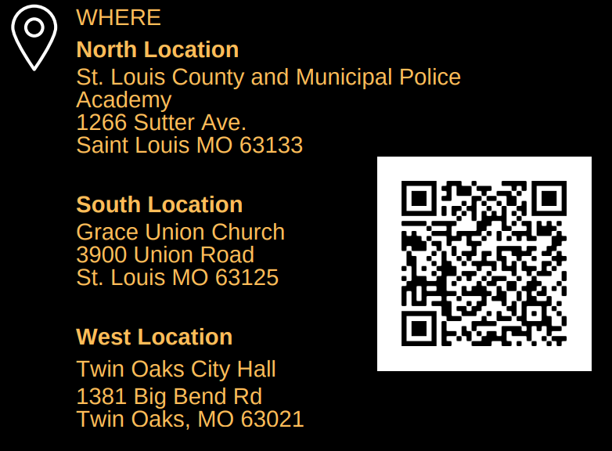
Citizens Police Academy Class 2022 - UPDATE http://stlcocpaaa.org/cpaaaclasses.html

Slide 14
Volunteer Opportunities - UPDATE
1st Precinct - North County Christmas Party - TBD
CPAAA Highway Cleanup - TBD
Please check the CPAAA Website for updates
http://stlcocpaaa.org/cpaaaevents.html
If any CPAAA Member is interested in these Volunteer Opportunities
Please Contact President - Cindy Vogelsang
president@stlcocpaaa.org – 314-680-1795

Slide 15
CPAAA Open Positions
Board Member - OPEN POSITION
If any CPAAA Member is interested in the Open Position
Please Contact President - Cindy Vogelsang
president@stlcocpaaa.org – 314-680-1795

Slide 16
CPAAA Facebook Private Group
https://www.facebook.com/groups/cpaaastlouiscounty

Slide 17
CPAAA North County Website
Vice- President - Ron Malone
http://stlcocpaaa.org

Slide 18
Comments and/or Questions
Open to the Floor CPAAA Members:
Suggestions or Recommendations
Please Email: President Cindy Vogelsang – president@stlcocpaaa.org
Or Mail To: P. O. Box 2136
Florissant, Mo 63032
These are comments and/or questions are kept on file for consideration.

Slide 19
Adjournment
President – Cindy Vogelsang

Slide 20
Next Quarterly Meeting
President – Cindy Vogelsang
CPAAA – 1st Bi-Monthly - General Meeting 2022
Tuesday 3/29/2022 @ 6:30PM
Chapel Of The Cross Lutheran Church
Room # 9a – Lower Level
11645 Benham Road
St. Louis, MO 63138

